Slide 1
RMCuff
David Baez - Team Member
Marc Roger - Team Member
Peter Dickson - Product Owner

Slide 2
Problem Definition
Elderly blood pressure patients face a problem, they lack a way to effectively leverage technology and the help of loved ones (caregivers) to stay on top of their blood pressure monitoring and reporting.
Mobile Applications for tracking blood pressure in older adults such as iHealth exist, but:
They lack functionality for the caregivers of a blood pressure patient to track results and set blood pressure schedules.
they fail to remain minimal and simple enough for the elderly to use easily.
Excess of functionality leads to use complexity and user interface complexity.

Slide 3
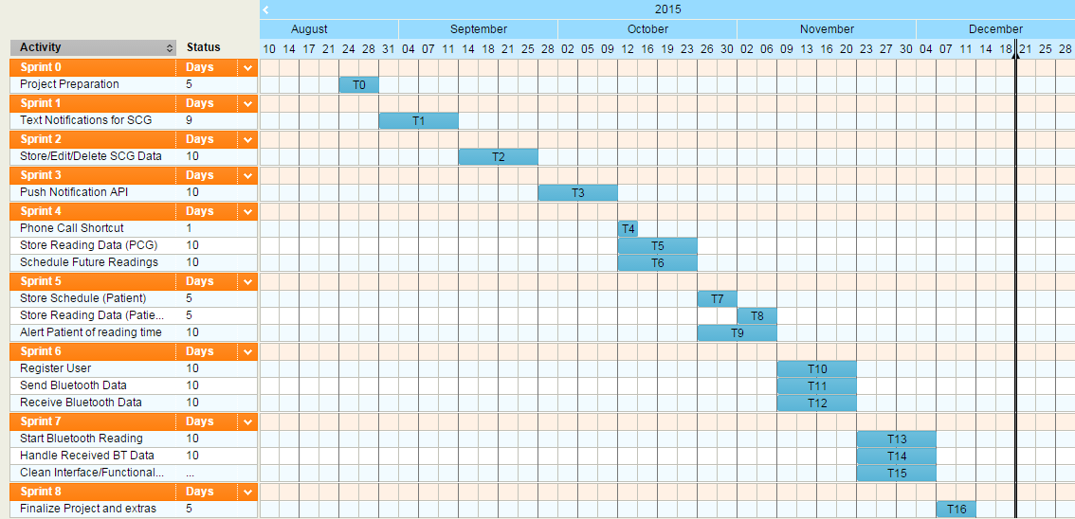
Project Management
Gantt Chart

Slide 4
Requirements
User Stories Implemented:
User Story # 666 - Text Notifications to Secondary Caregivers (Required)
As a Primary Caregiver, I want to automatically or manually send text notifications to secondary caregivers. So that I can alert other family members or professionals about the patient’s status.
User Story # 669 - Store Editable Secondary Caregiver Data (Required)
As a Primary Caregiver, I want a stored database (I can edit) of secondary caregiver’s names, phone numbers, and a checkbox of whether I want to send them notifications. So that I can easily manage the people I am sending text notifications to.
User Story # 673 - Pull Patient new reading data as Primary Caregiver (Required)
As a Primary Caregiver, I want to be alerted when the Patient completes a reading (via push notification). So that I can be certain the reading was taken.
User Story # 675 - Push schedule to Patient (Required)
As a Primary Caregiver, I want to be able to alert the patient (via push notification) when I create a new scheduled reading. So that they receive a push notification and take their blood pressure reading on time.

Slide 5
Requirements
User Stories Implemented (Cont):
User Story # 676 - Push new reading data to Primary Caregiver (Required)
As a Patient, I want to notify a Primary Caregiver (via push notification) when I take a blood pressure reading. So that they know I’ve taken my reading.
User Story # 677 - Pull Schedule Update as Patient (Required)
As a Patient, I’d like to be alerted (via push notification) when my Primary Caregiver schedules a blood pressure reading. So that I know when to prepare for the reading.
User Story # 674 - Store past reading data on Primary Caregiver side (Required)
As a Primary Caregiver, I want to be able to see data from past readings so that I can track the Patient’s progress.
User Story # 670 - Schedule Future Reading (Required)
As a Primary Caregiver, I’d like to schedule readings for the patient and keep a list of upcoming scheduled readings. So that I have control over when the patient takes their reading.

Slide 6
Requirements
User Stories Implemented (Cont):
User Story #686 - Shortcut for Phone Calls (Optional)
As a user, I want a shortcut button so that I can call the Patient / Primary Caregiver without manually exiting the application. So that, I can more easily connect to the opposite party.
User Story # 679 - Store reading Schedule on Patient Side (Required)
As a Patient, I’d like to keep a list of upcoming scheduled readings. So that I know ahead of time when my readings will take place.
User Story # 671 - Store Past Readings Data on Patient Side (Required)
As a Patient, I want to be able to see data from past readings so that I can track my progress.
User Story # 678 - Alert patient of reading time (Required)
As a Patient, I’d like to be alerted (via push notification) when it is time for a scheduled reading. So that I don’t miss the reading.
User Story # 667 - Send Bluetooth Data (Required)
As a Patient, I want to be able to activate my blood pressure cuff from my smartphone app (send bluetooth data) So that I can begin my blood pressure test.

Slide 7
Requirements
User Stories Implemented (Cont):
User Story # 668 - Receive Bluetooth Data (Required)
As a Patient, I want to be able to receive data (via bluetooth) from my blood pressure cuff to my smartphone app. So that I can receive my blood pressure reading.
User Story # 697 - Register as a user (Required)
As a user, I want to be able to register on my first use (using my phone number as a unique identifier) so that I can receive/send push notifications.
User Story # 706 - Start Bluetooth Reading (Required)
As a patient, we want our device to connect to the BT device and initiate a reading so that we can measure our blood pressure.
User Story # 707 - Receive Reading Data via Bluetooth (Required)
As a patient, we would like to receive the reading data from the bluetooth device, once the reading is complete. So that we can have that information stored on our phone and sent to our caregiver.
User Story # 708 - Clean interface and functionality (Required)
As a user, I want to navigate a clean interface with polished functionality, so that I can focus on my blood pressure (patient) or tracking someone’s blood pressure (caregiver).

Slide 8
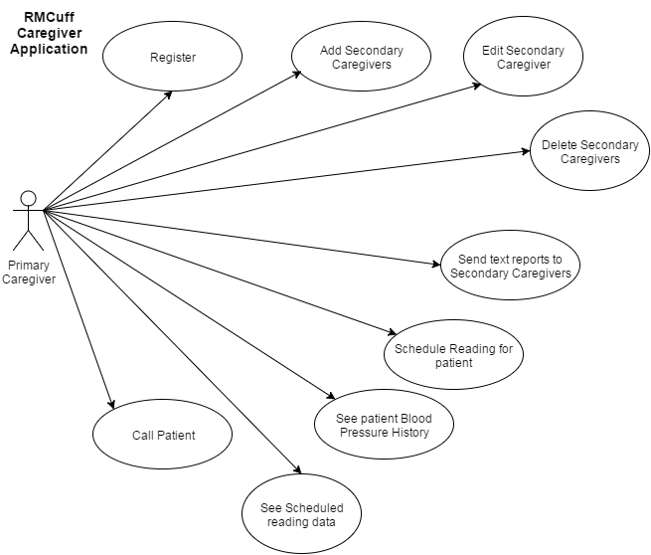
Requirements
Use Case Diagram

Slide 9
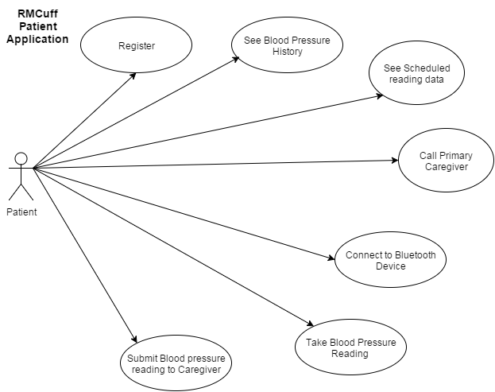
Requirements
Use Case Diagram

Slide 10
System Design
System Decomposition
Model View Controller (MVC) Architecture - We make use of this pattern to separate user interface code, data access code, and interaction code, making it easier to modify one without affecting the other.
Client/Server Architecture - We implemented a custom php web service hosted on our web server which we communicate with via the app. This web service handles the sending of push notifications. One app sends data up to the server, the server takes that data and sends it to the specified user.

Slide 11
System Design
System Deployment
The software resources that will be used to develop the system from beginning to end are:
Android Studio - Android’s official integrated development environment (IDE)
Java JDK - Includes tools for developing, debugging, and monitoring Java applications
Android SDK - Includes development tools, an emulator, and required libraries to build Android applications
Java - Programming language used in native Android applications
Arduino IDE - Used for programming the arduino bluetooth device
PushBots - A push notification service used to send implemented to send push notifications between the 2 different apps and have them wake automatically.
GitHub - Online repository that will store our project code
Mingle - Used for planning scrum sprints
The hardware resources that will be used to develop the system from beginning to end are:
Any computer that meets the specifications required by Android Studio
Any Android device to test the application on
A custom bluetooth blood pressure cuff to connect to

Slide 12
System Design
Persistent Data Design
All persistent data is stored locally in phone data using a modified model of the Android Shared Preferences in a dictionary Key:Value style.
We were able to grow upon this by serializing entire objects and classes into value objects using a modified JSON called GSON.
This allowed us to store caregivers, schedules, readings, etc as an entire class object rather than string values.

Slide 13
System Design
Security/Privacy
Security was considered a non issue by the Product Owner for Version 1 of the application.
Most of the development process was focused on prototyping user functionality, however, obvious steps such as serialization locally stored user data were taken for security reasons.

Slide 14
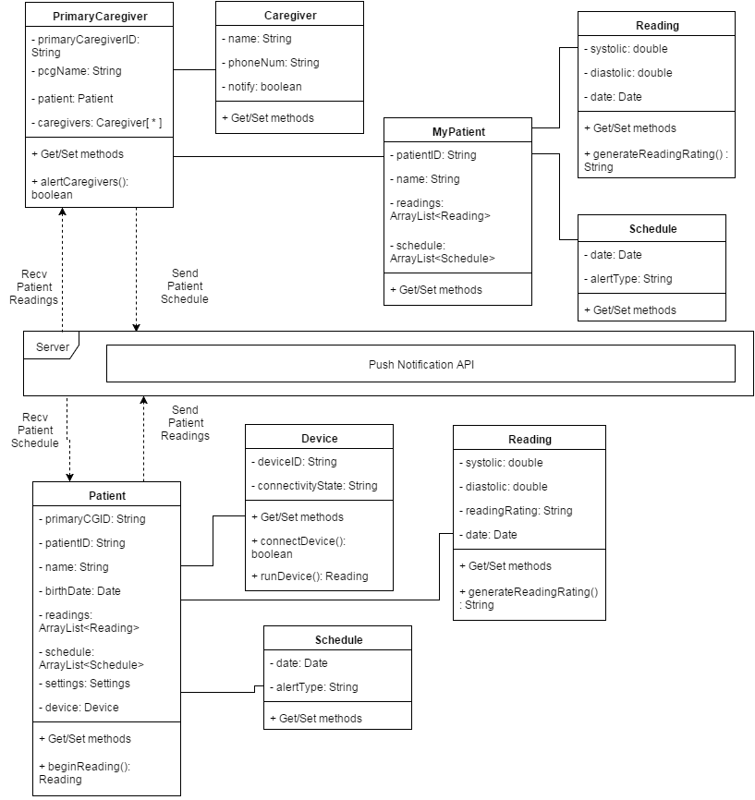
Detailed Design
Class Diagram

Slide 15
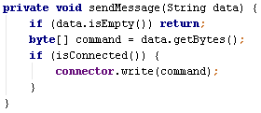
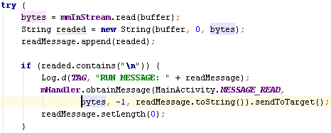
Test Suites and Test Cases
Sunny Day
One of our sunny day test cases considered of being able to stub a message call to the bluetooth device and verify on a response from the bluetooth device.
This test turned out to be a bit complicated as it require bugless operation of the bluetooth device.

Slide 16
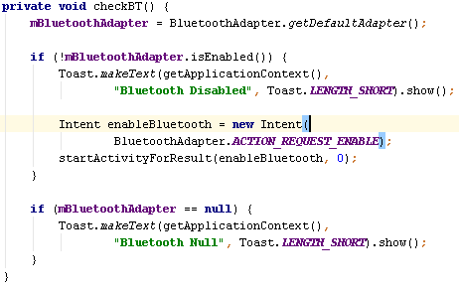
Test Suites and Test Cases
Rainy Day
One of our rainy day test cases involved the chance that the bluetooth cuff was out of range, or ran out of batter, or some other form of incapacitation.
These tests allowed us to handle these instances and eventually led us to implement the functionality to control the phone's bluetooth usage from our app.

Slide 17
Test Suites and Test Cases
Automated test script
Our automated test scripts involved the usage of an Android Emulator as well as using the JUnit functionality built into android studio.
This allowed us to use testing driven development to make sure that all changes that were made to project passed all previous test cases and that each user story had a test case tied to it.
This way if any new code was to be added and one test did not pass then we would know that the code needed to be changed so that all test cases passed.

Slide 18
Demo
Follow these links for a video demo of each application:
Caregiver Application: https://youtu.be/8VFnQa2ii1E
Patient Application: https://youtu.be/TCeZiGv6NKI

